Slide 1
BIG DATA
WELCOME
TO

Slide 2
Cap Theorem
Consistency
Availability
Partition tolerance

Slide 3
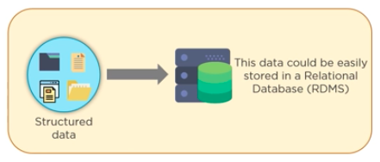
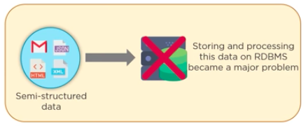
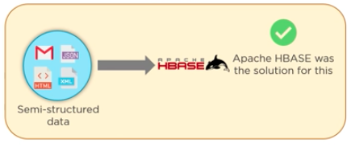
History

Slide 4
Hbase
HBase is a column-oriented database management system derived from Google's NoSQL database ”Big Table” that runs on HDFS

Slide 5
Hbase Use case
Stores billions of records of rows
Perform faster processing of records using SQL queries
Used in industries likes
Medical
E-commerce
Sports

Slide 6
Hbase Features
Scalable
Automatic Failure Support
Consistent read and write
Java API

Slide 7
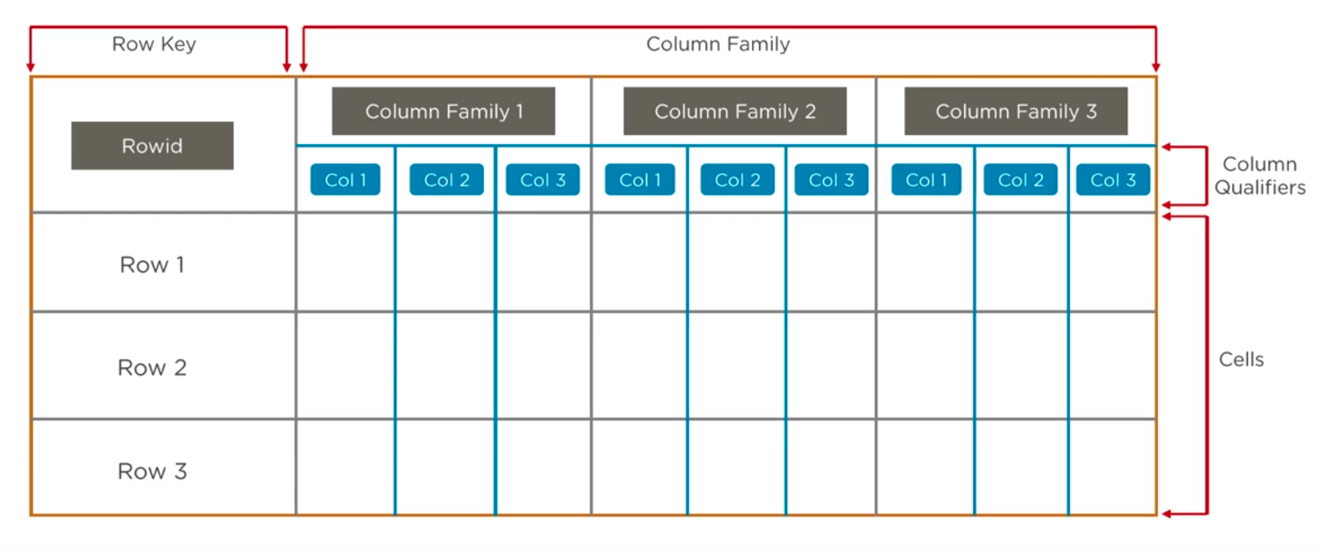
Hbase column Storage

Slide 8
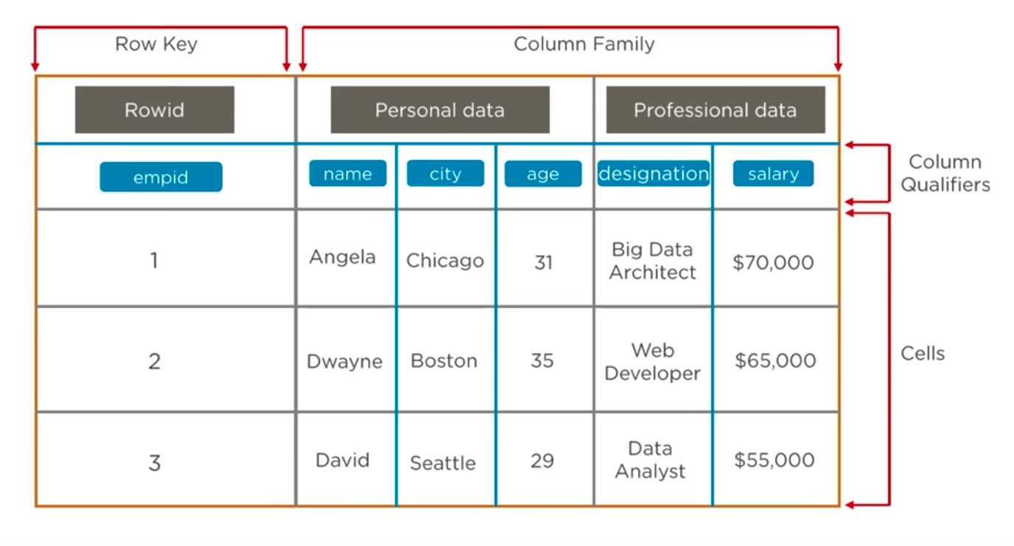
Hbase column Storage

Slide 9
Architecture

Slide 10
Regions
Region
Consists of all the rows between the start key and the end key which are assigned to that Region.

Slide 11
Zookeeper
Zookeeper
Distributed coordination service
Maintain server state in the HBase Cluster

